Slide 1
Valence Shell Electron Repulsion Theory

Slide 2
Assumptions – Molecular Center
In order to predict the geometry of molecules, Nyholm and Gillespie developed a qualitative model known as Valence Shell Electron Pair Repulsion Theory (VSEPR Theory). The basic assumptions of this theory are summarized below.
1) The electron pairs in the valence shell around the central atom of a molecule repel each other and tend to orient in space so as to minimize the repulsions and maximize the distance between them.

Slide 3
What is it?
Valence shell electron pair repulsion (VSEPR) theory is a model used, in chemistry, to predict the geometry of individual molecules from the number of electron pairs surrounding their central atoms

Slide 4
Assumptions - Electron Pairs
2) There are two types of valence shell electron pairs
Bond pairs
Lone pairs
Bond pairs are shared by two atoms and are attracted by two nuclei. Hence they occupy less space and cause less repulsion.
Lone pairs are not involved in bond formation and are in attraction with only one nucleus. Hence they occupy more space. As a result, the lone pairs cause more repulsion.
The order of repulsion between different types of electron pairs is as follows:
Lone pair - Lone pair > Lone Pair - Bond pair > Bond pair - Bond pair
NB: The bond pairs are usually represented by a solid line, whereas the lone pairs are represented by a lobe with two electrons.

Slide 5
Assumptions – Multiple bond repulsion
3) In VSEPR theory, the multiple bonds are treated as if they were single bonds. The electron pairs in multiple bonds are treated collectively as a single super pair.
The repulsion caused by bonds increases with the increase in the number of bonded pairs between two atoms i.e., a triple bond causes more repulsion than a double bond which in turn causes more repulsion than a single bond.

Slide 6
Assumptions – Molecular shapes
4) The shape of a molecule can be predicted from the number and type of valence shell electron pairs around the central atom.
When the valence shell of central atom contains only bond pairs, the molecule assumes symmetrical geometry due to even repulsions between them.
However the symmetry is distorted when there are also lone pairs along with bond pairs due to uneven repulsion forces.

Slide 7
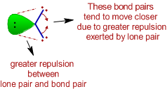
Assumptions – Molecular shapes (lone pair effect)
5) Effects on bond angle and shape:
The bond angle decreases due to the presence of lone pairs, which cause more repulsion on the bond pairs and as a result the bond pairs tend to come closer.

Slide 8
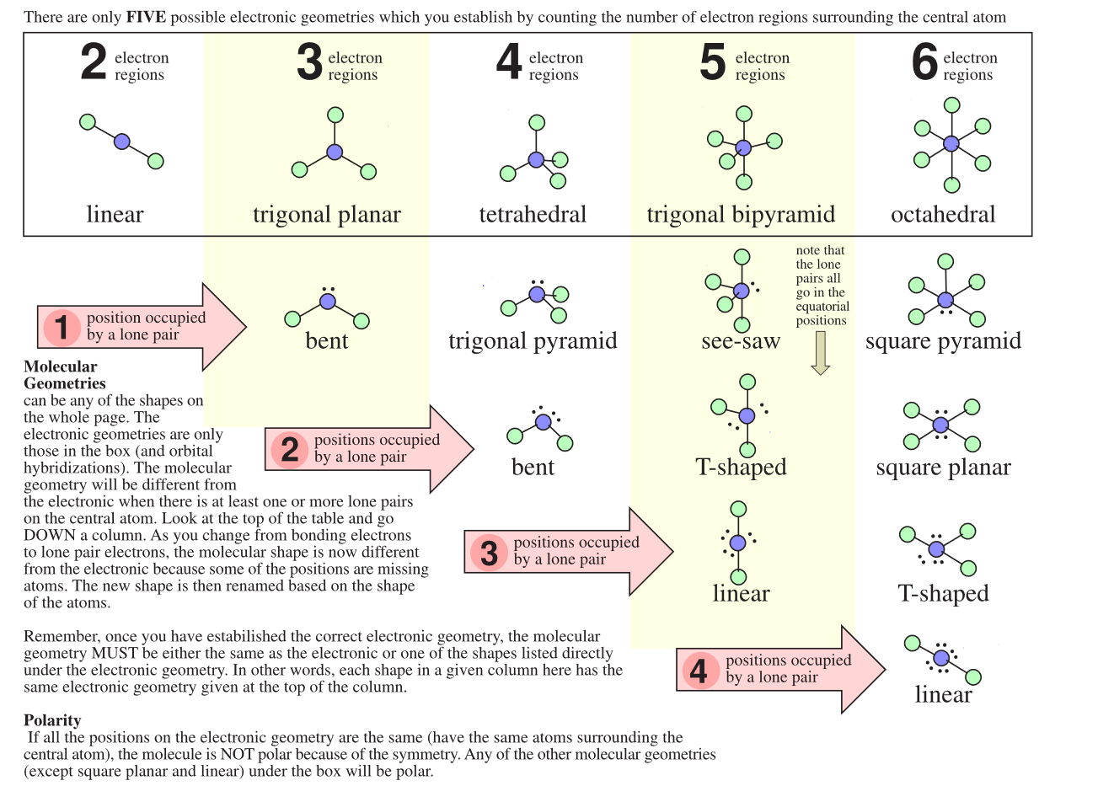
Look at the angles in your book for what you need to know. There are 5 main angles you need to know.
109.5^{O}, 180^{O}, 120^{O}, 107.5^{O}, 104.5^{O} ← in that order of importance

Slide 9
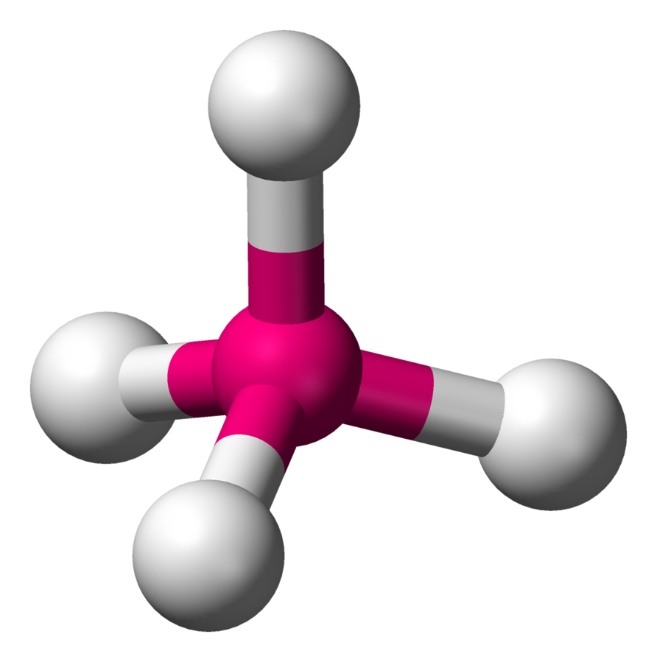
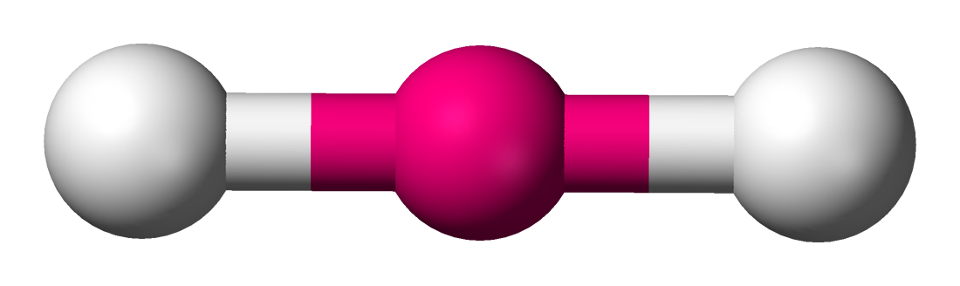
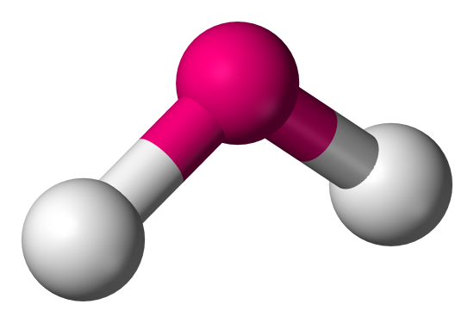
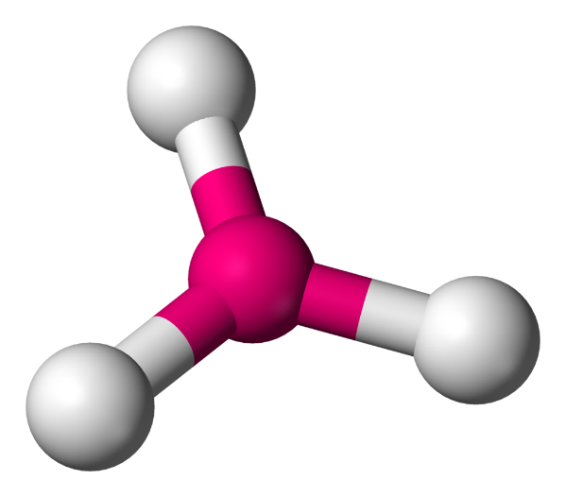
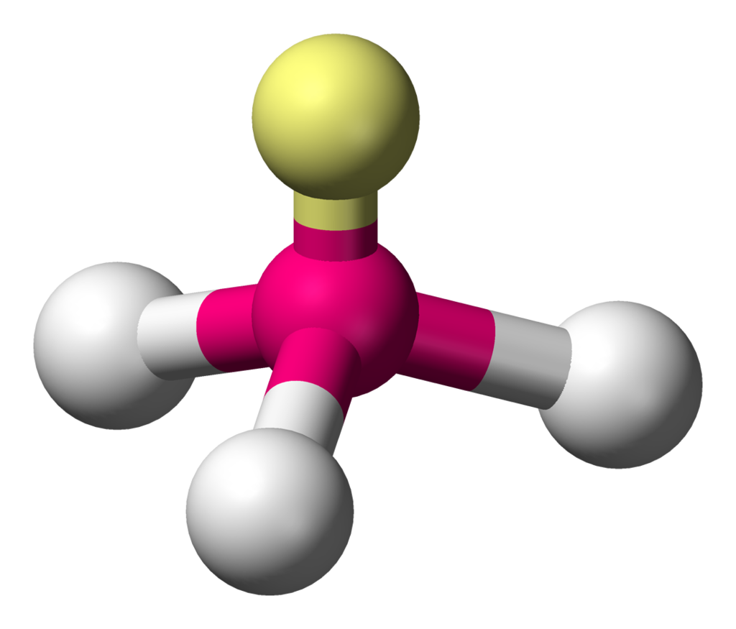
The Shapes -
Linear Tetrahedral
Bent
Pyramidal Trigonal Planar

